Slide 1
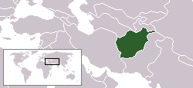
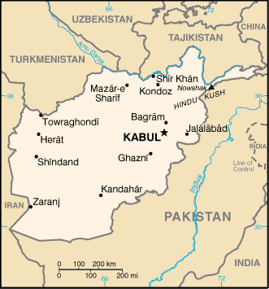
Afghanistan 1
Size: 251,827 square miles
Population: 39,232,003
Date of Nationhood: Jan. 6, 2004
Capital: Kabul
GDP/capita: $1,500 #9-11 less
Major Religion: Sunni Muslim 85%, Shi’a Muslim 15%

Slide 2
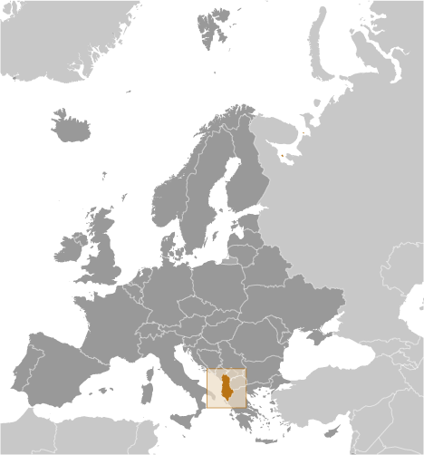
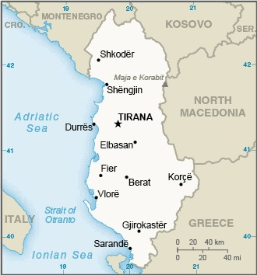
Albania 2
Size: 11,100 square miles
Population: 3,101,621
Date of Nationhood: November 28, 1912 from the Ottoman Empire
Capital: Tirana
GDP/capita: $14,500
Major religions: Muslim 57%,
Albanian Orthodox 7%,
Catholic 10%

Slide 3
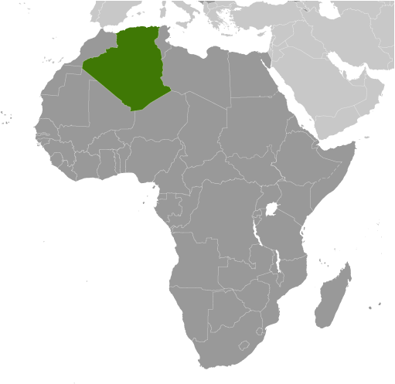
Algeria 3
Size: 919,595 square miles #10
Population: 44,758,398
Date of Nationhood: July 5, 1962 from France
Capital: Algiers
GDP/capita: $11,000
Major religions: Sunni Muslim (state religion) 99%

Slide 4
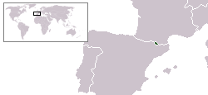
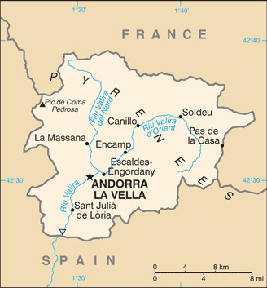
Andorra 4
Size: 181 square miles #17
Population: 85,468 #11 less
Date of Nationhood: 1287 (National Day: September 8)
Capital: Andorra la Vella
GDP/capita: $49,900 #20 same
Major religions: Roman Catholic (predominant)

Slide 5
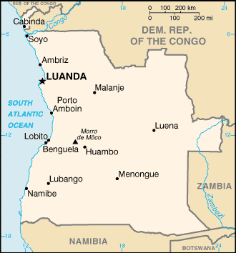
Angola 5
Size: 481,353 square miles
Population: 35,981,281
Date of Nationhood: November 1, 1975 from Portugal
Capital: Luanda
GDP/capita: $5,900 less
Major Religions: Catholic 41%, Protestant 38%, none 12%

Slide 6
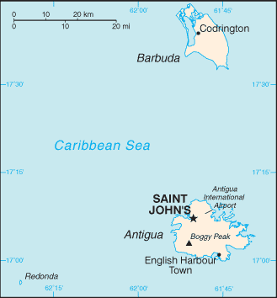
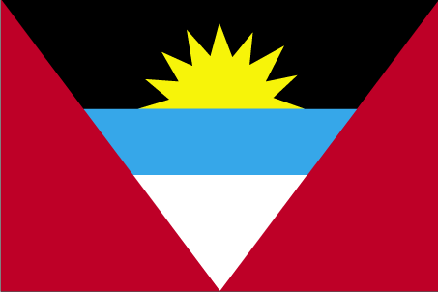
Antigua and Barbuda 6
Size: 171 square miles #14
Population: 101,489 #15
Date of Nationhood: November 1, 1981 from UK
Capital: Saint John’s
GDP/capita: $19,100
Major religions: Protestant 68%, Catholic 8%, none 6%

Slide 7
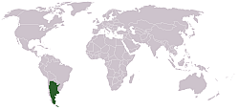
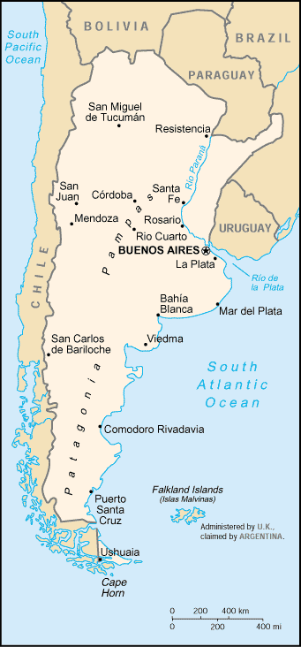
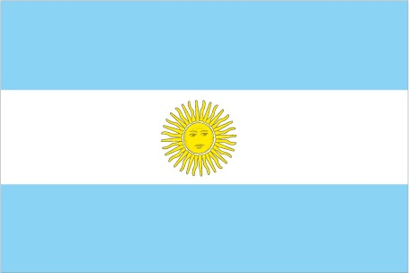
Argentina 7
Size: 1,073,518 square miles #8
Population: 46,621,847
Date of nationhood: 1816, from Spain
Capital: Buenos Aires
GDP/capita: $11,500
Major Religions: Roman Catholic 63%, Protestant 15%, none 19%

Slide 8
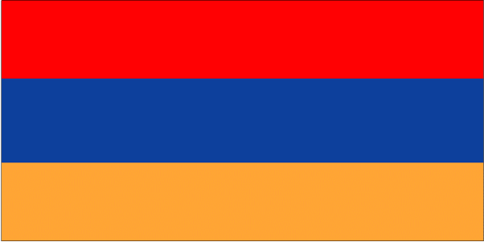
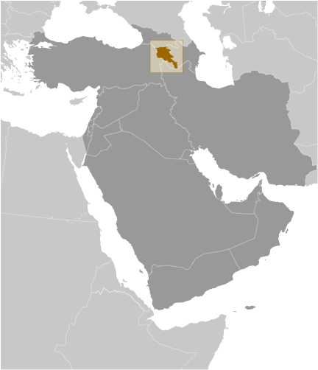
Armenia 8
Size: 11,483 square miles
Population: 2,989,091 less
Date of Nationhood: September 23, 1991 from Soviet Union
Capital: Yerevan
GDP/capita: $14,200
Major Religions: Armenian Apostolic 93%, Other Christian 3%

Slide 9
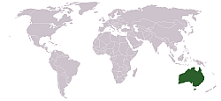
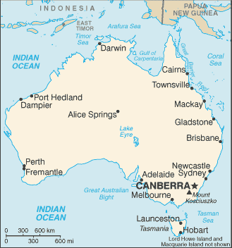
Australia 9
Size: 2,988,901 square miles #6
Population: 26,461,166
Date of Nationhood: January
1, 1901 from the UK
Capital: Canberra
GDP/capita: $49,800
Major religions: Catholic 23%, Anglican 13%, Other Christian 10% Buddhist 2%, Muslim 2%,none 30%

Slide 10
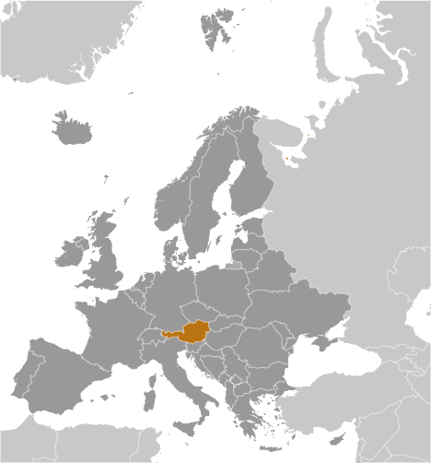
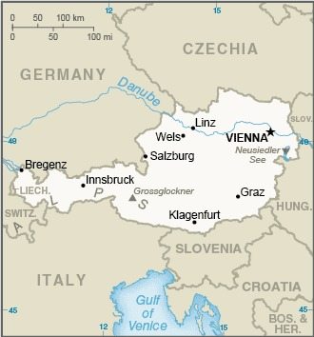
Austria 10
Size: 32,382 square miles
Population: 8,940,860
Date of Nationhood: July 27, 1955
Capital: Vienna
GDP/capita: $54,100 #15
Major religions: Catholic 57%, Protestant 3%, Muslim 8%, Orthodox 9%, none 23%

Slide 11
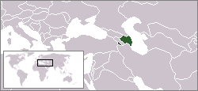
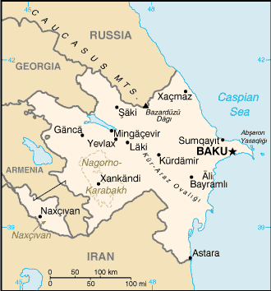
Azerbaijan 11
Size: 33,436 square miles
Population: 10,420,515
Date of Nationhood: August 30, 1991 from Soviet Union
Capital: Baku
GDP/capita: $14,400
Major religions: Muslim 97%, Christian 3%

Slide 12
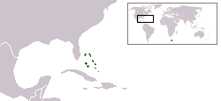
The Bahamas 12
Size: 5,359 square miles
Population: 358,508
Date of Nationhood: July 10, 1973 from the UK
Capital: Nassau
GDP/capita: $30,200 less
Major religions: Baptist 35%, Anglican 14%, Catholic 12%, Pentecostal 9%, Other Christian 24%

Slide 13
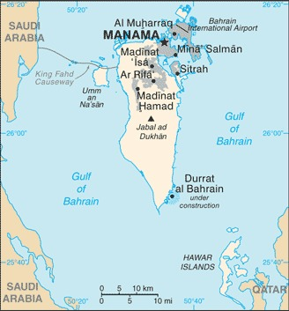
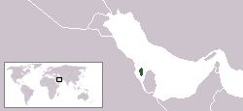
Bahrain 13
Size: 293 square miles
Population: 1,553,886
Date of Nationhood: Aug. 15, 1971 from Britain
Capital: Manama
GDP/capita: $49,400
Major religions: Muslim 74%, Christian 9%, other 17%

Slide 14
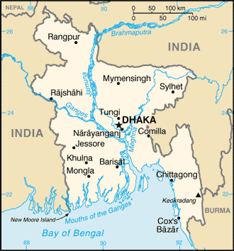
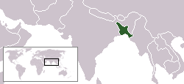
Bangladesh 14
Size: 55,597 square miles
Population: 167,184,465 #8
Date of Nationhood: March 26, 1971 from Pakistan
Capital: Dhaka
GDP/capita: $5,900
Major religions: Muslim 88%, other 12%

Slide 15
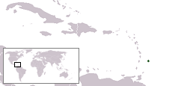
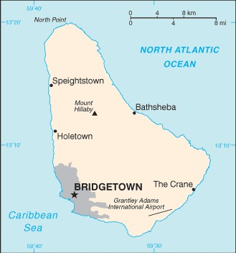
Barbados 15
Size: 166 square miles #13
Population: 303,431
Date of Nationhood: November 30, 1966 from UK
Capital: Bridgetown
GDP/capita: $13,800
Major Religions: Protestant 66%, Catholic 4%, None 21%,
other Christian 5%, other 4%

Slide 16
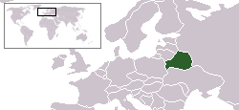
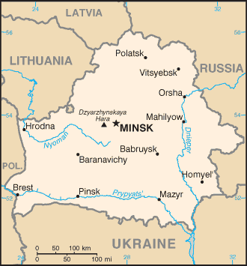
Belarus 16
Size: 80,155 square miles
Population: 9,383,853 less
Date of Nationhood: July 3, 1990 from USSR
Capital: Minsk
GDP/capita: $19,800
Major Religions: Eastern Orthodox 48%, Catholic 7%, none 41%

Slide 17
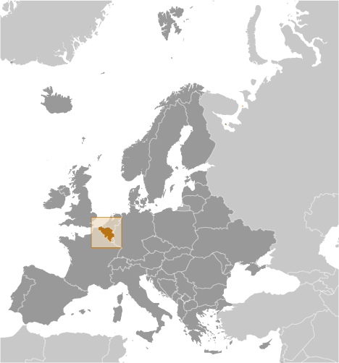
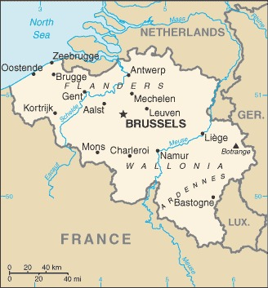
Belgium 17
Size: 11,786 square miles
Population: 11,913,633
Date of Nationhood: 1830 from the Netherlands
Capital: Brussels
GDP/capita: $51,700 #19
Major Religions: Roman Catholic 57%, Protestant 2%, Muslim 7%, none 29%

Slide 18
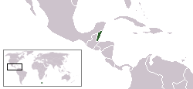
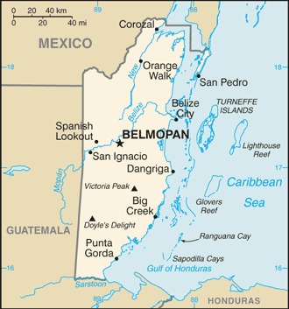
Belize 18
Size: 8,867 square miles
Population: 419,137
Date of Nationhood: September 21, 1981 from UK
Capital: Belmopan
GDP/capita: $8,800
Major Religions: Catholic 40%, Protestant 32%, other 11%, none 15%

Slide 19
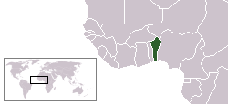
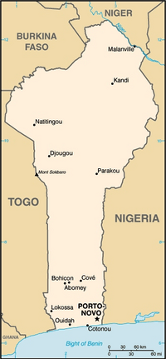
Benin 19
Size: 43,483 square miles
Population: 14,219,908
Date of Nationhood: August 1, 1960 from France
Capitals: Porto-Novo and Cotonou
GDP/capita: $3,300 same
Major Religions: Christianity 49%, Muslim 28%, Vodoun 12%, none 6%

Slide 20
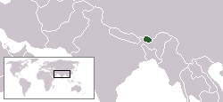
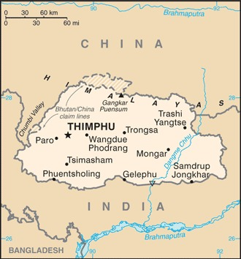
Bhutan 20
Size: 14,824 square miles
Population: 876,181
Date of Nationhood: 1907
Capital: Thimphu
GDP/capita: $10,900 same
Major Religions: Buddhist 75%, Hinduism 22%

Slide 21
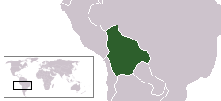
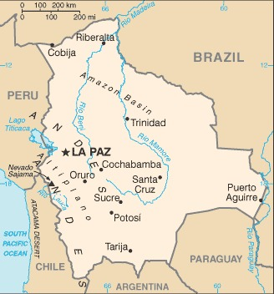
Bolivia 21
Size: 424,164 square miles
Population: 12,186,079
Date of Nationhood: August 6, 1825 from Spain
Capitals: La Paz and Sucre
GDP/capita: $8,100
Major Religions: Catholic 70%, Protestant 17%

Slide 22
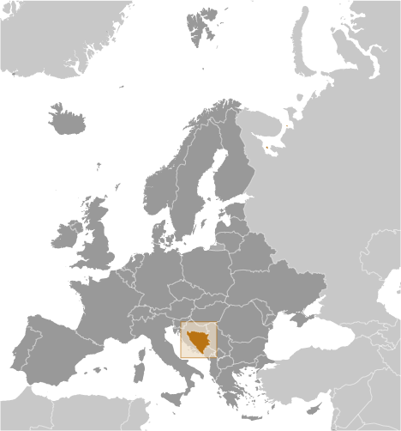
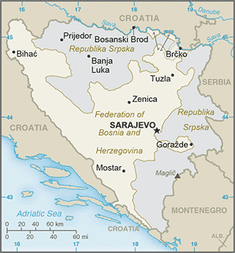
Bosnia and Herzegovina
22
Size: 19,767 square miles
Population: 3,807,764 less
Date of Nationhood: April 5, 1992 from Yugoslavia
Capital: Sarajevo
GDP/capita: $15,700
Major Religions: Muslim 51% Orthodox 31%,Catholic 15%

Slide 23
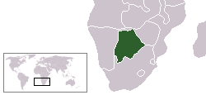
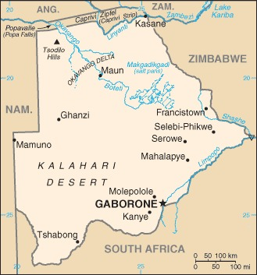
Botswana 23
Size: 224,607 square miles
Population: 2,417,596
Date of Nationhood: September 30, 1966 from UK
Capital: Gaborone
GDP/capita: $14,800 less
Major Religions: Christian 79%, Badimo 4%, other 2%, none 15%

Slide 24
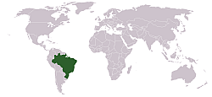
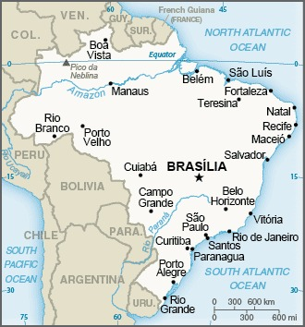
Brazil 24
Size: 3,287,612 square miles #5
Population: 218,689,757 #7
Date of Nationhood:
September 7, 1822 from Portugal
Capital: Brasilia
GDP/capita: $14,600
Major Religions: Roman Catholic 65%, None 8%, Protestant 22%

Slide 25
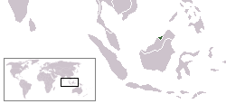
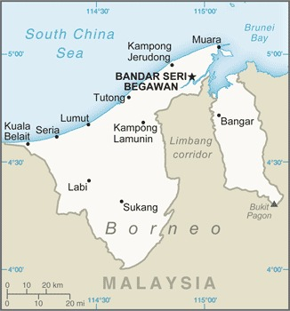
Brunei 25
Size: 2,226 square miles
Population: 484,991
Date of Nationhood: January 1, 1984 from Great Britain
Capital: Bandar Seri Begawan
GDP/capita: $60,100 #11 less
Major Religions: Muslim 81%, Buddhist 7%, Christianity 7%, other 5%

Slide 26
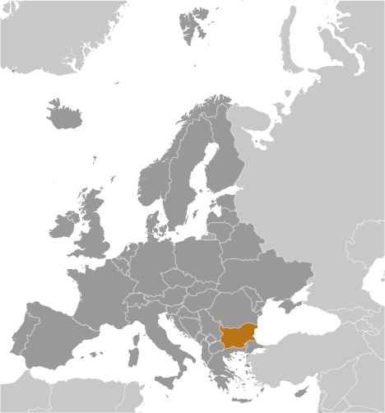
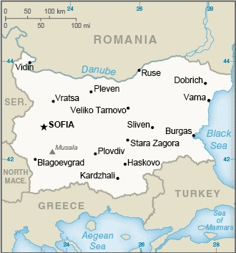
Bulgaria 26
Size: 42,810 square miles
Population: 6,827,736 less
Date of Nationhood: March 3, 1878 from Ottoman Empire
Capital: Sofia
GDP/capita: $24,400
Major Religions: Eastern Orthodox 59%, Muslim 8%

Slide 27
Burkina Faso 27
Size: 105,869 square miles
Population: 22,489,126
Date of Nationhood: August 5, 1960 from France
Capital: Ouagadougou
GDP/capita: $2,200 same
Major Religions: Muslim 63%, Indigenous beliefs 8%, Catholic 25%, Protestant 7%

Slide 28
Burma 28
Size: 261,228 square miles
Population: 57,970,293
Date of Nationhood: Jan. 4, 1948 from Britain
Capital: Nay Pyi Taw
GDP/capita: $4,000 less
Major Religions: Buddhist 88%, Christian 6%, Muslim 4%, Animism 1%

Slide 29
Burundi 29
Size: 10,745 square miles
Population: 13,162,952
Date of Nationhood: July 1, 1962 from Belgium
Capital: Bujumbura
GDP/capita: $700 #1
Major Religions: Roman Catholic 59%, Muslim 3%, Protestant 35%,

Slide 30
Cabo Verde 30
Size: 1,557 square miles
Population: 603,901
Date of Nationhood: July 5, 1975 from Portugal
Capital: Praia
GDP/capita: $6,100
Major Religions: Catholic 77%, Protestant 5%

Slide 31
Cambodia 31
Size: 69,898 square miles
Population: 16,891,245
Date of Nationhood: November 9, 1953 from France
Capital: Phnom Penh
GDP/capita: $4,400
Major Religions: Buddhism 97%, Islam 2%

Slide 32
Cameroon 32
Size: 183,568 square miles
Population: 30,135,732
Date of Nationhood: January 1, 1960 from France
Capital: Yaoundé
GDP/capita: $3,700
Major Religions: Indigenous 2%, Catholic 38%, Muslim 24%, Protestant 26%

Slide 33
Canada 33
Size: 3,855,101 square miles #2
Population: 38,516,736
Date of Nationhood: July 1, 1867 from UK July 1, 1867
Capital: Ottawa
GDP/capita: $47,900
Major Religions: Catholic 39%, Protestant 20%, Muslim 3%, none 24%

Slide 34
Central African Republic 34
Size: 240,535 square miles
Population: 5,552,228
Date of Nationhood: August 13, 1960 from France
Capital: Bangui
GDP/capita: $800 #2 less
Major Religions: Indigenous 1%, Christian 89%, Muslim 9%

Slide 35
Chad 35
Size: 495,755 square miles #20
Population: 18,523,165
Date of Nationhood: August 11, 1960 from France
Capital: N’Djamena
GDP/capita: $1,400
#7-8 less
Major Religions: Muslim 52%, Catholic 20%, Protestant 24%, none 3%

Slide 36
Chile 36
Size: 291,932 square miles
Population: 18,549,457
Date of Nationhood: February 12, 1818 from Spain
Capital: Santiago
GDP/capita: $25,400
Major Religions: Roman Catholic 60%, Protestant 18%, None 17%

Slide 37
China 37
Size: 3,705,407 square miles #4
Population: 1,413,142,846 #2
Date of Nationhood: October 1, 1949
Capital: Beijing
GDP/capita: $17,600
Major Religions: Atheism 52%, Buddhism 18%, Folk religion 22%, Muslim 2%, Christian 5%

Slide 38
Colombia 38
Size: 439,735 square miles
Population: 49,336,454
Date of Nationhood: August 7, 1819 from Spain
Capital: Bogotá
GDP/capita: $14,600
Major Religions: Christian 92%, None 7%

Slide 39
Comoros 39
Size: 862 square miles
Population: 888,378
Date of Nationhood: July 6, 1975 from France
Capital: Moroni
GDP/capita: $3,200
Major Religions: Muslim 98%, Christian 2%

Slide 40
Democratic Republic of Congo 40
Size: 905,354 square miles #11
Population: 111,859,928 #14
Date of Nationhood: June 30, 1960 from Belgium
Capital: Kinshasa
GDP/capita: $1,100 #3-4
Major Religions: Catholic 30%, Protestant 27%, Kimbanguist 3%, other Christian 37%, Muslim 1%

Slide 41
Republic of Congo 41
Size: 132,047 square miles
Population: 5,677,493
Date of Nationhood: August 15,1960 from France
Capital: Brazzaville
GDP/capita: $3,200 less
Major Religions: Catholic 33%, Other Christian 42%, Islam 2%

Slide 42
Costa Rica 42
Size: 19,730 square miles
Population: 5,256,612
Date of Nationhood: September 15, 1821 from Spain
Capital: San Jose
GDP/capita: $21,200
Major Religions: Roman Catholic 48%, Protestant 22%, None 27%

Slide 43
Cote d’Ivoire 43
Size: 124,503 square miles
Population: 29,344,847
Date of Nationhood: August 7, 1960 from France
Capital: Yamoussoukro
GDP/capita: $5,300
Major Religions: Muslim 43%, Catholic 17%, Protestant 17%, None 19%

Slide 44
Croatia 44
Size: 21,851 square miles
Population: 4,169,239 less
Date of Nationhood: June 25, 1991 from Yugoslavia
Capital: Zagreb
GDP/capita: $31,600
Major Religions: Roman Catholic 86%, Orthodox 4%

Slide 45
Cuba 45
Size: 42,803 square miles
Population: 10,982,974 less
Date of Nationhood: 1902 from the US
Capital: Havana
GDP/capita: $12,300 same
Major Religions: Christian 59%, folk 17%, none 23%

Slide 46
Cyprus 46
Size: 3,571 square miles
Population: 1,308,120 less
Date of Nationhood: August 16, 1960 from the UK
Capital: Nicosia
GDP/capita: Greek: $41,700 Turkish: $15,109
Major Religions: Greek Orthodox 78%, Muslim 18%

Slide 47
Czechia 47
Size: 30,450 square miles
Population: 10,706,242
Date of Nationhood: Jan. 1, 1993
Capital: Prague
GDP/capita: $40,700
Major Religions: Catholic 7%, Protestant 6%, None 47%

Slide 48
Denmark 48
Size: 16,639 square miles
Population: 5,946,984
Date of Nationhood: 1128
Capital: Copenhagen
GDP/capita: $58,000 #12
Major Religions: Evangelical Lutheran 75%, Muslim 6%

Slide 49
Djibouti 49
Size: 8,957 square miles
Population: 976,143
Date of Nationhood: June 27, 1977 from France
Capital: Djibouti
GDP/capita: $4,900 less
Major Religions: Muslim 94%, Other 6%

Slide 50
Dominica 50
Size: 289 square miles
Population: 74,656 #9
Date of Nationhood: Nov. 3, 1978 from Britain
Capital: Roseau
GDP/capita: $10,900
Major Religions: Catholic 53%, Protestant 30%

Slide 51
Dominican Republic 51
Size: 18,791 square miles
Population: 10,790,744
Date of Nationhood: 1821 from Spain
Capital: Santo Domingo
GDP/capita: $18,600
Major Religions: Catholic 44%, Protestant 21%, None 29%

Slide 52
Ecuador
52
Size: 109,483 square miles
Population: 17,483,326
Date of Nationhood: May 13, 1830
Capital: Quito
GDP/capita: $10,700
Major Religions: Catholic 69%, Protestant 18%, None 10%,

Slide 53
Egypt 53
Size: 386,662 square miles
Population: 109,546,720 #15
Date of Nationhood: June 18,1953 from Britain
Capital: Cairo
GDP/capita: $11,600 less
Major Religions: Muslim 90%, Coptic Orthodox 9%, other Christian 1%

Slide 54
El Salvador 54
Size: 8,124 square miles
Population: 6,602,370
Date of Nationhood: 1821 from Spain
Capital: San Salvador
GDP/ capita: $9,100
Major Religion: Roman Catholic 50%, Protestant 36%, None 12%

Slide 55
Equatorial Guinea 55
Size: 10,831 square miles
Population: 1,737,695
Date of Nationhood: Oct. 2, 1968 from Spain
Capital: Malabo
GDP/capita: $14,600 less
Major Religions: Catholic 88%,Protestant 5%, Muslim 2%, other 5%

Slide 56
Eritrea 56
Size: 45,405 square miles
Population: 6,274,796
Date of Nationhood: May 24, 1993 from Ethiopia
Capital: Asmara
GDP/capita: $1,600 #12-14 same
Major Religions: Muslim, Eritrean Orthodox, Catholic, Lutheran, Muslim

Slide 57
Estonia 57
Size: 17,462 square miles
Population: 1,202,762 less
Date of Nationhood: August 20, 1991 from Soviet Union
Capital: Tallinn
GDP/capita: $38,700
Major Religions: Lutheran 10%, Orthodox 16%, Other Protestant 2%, None 54%

Slide 58
Eswatini 58
Size: 6,704 square miles
Population: 1,130,043
Date of Nationhood: September 6, 1968 from Britain
Capital: Mbabane and Lobamba
GDP/capita: $8,900
Major Religions: Zionist 40%, Catholic 20%, other Christian 30%, Muslim 2%

Slide 59
Ethiopia 59
Size: 426,372 square miles
Population: 116,462,712 #12
Date of Nationhood: 1941
from Italy
Capital: Addis Ababa
GDP/capita: $2,300 same
Major Religions:
Muslim 31%, Ethiopian Orthodox 44%, Protestant 23%

Slide 60
Fiji 60
Size: 7,055 square miles
Population: 947,760
Date of Nationhood: Oct. 10, 1970 from Britain
Capital: Suva
GDP/capita: $10,400 less
Major Religions: Catholic 9%, Protestant 45%, Hindu 28%, Muslim 6%

Slide 61
Finland 61
Size: 130,558 square miles
Population: 5,614,571
Date of Nationhood: Dec. 6, 1917 from Russia
Capital: Helsinki
GDP/capita: $48,800
Major Religions: Lutheran 67%, Other Christian 1%, none 30%

Slide 62
France 62
Size: 248,572 square miles
Population: 68,521,974
Date of Nationhood:
around 800
Capital: Paris
GDP/capita: $45,000
Major Religions: Catholic 47%, Muslim 4%, Jewish 1%, none 33%

Slide 63
Gabon 63
Size: 103,347 square miles
Population: 2,397,368
Date of Nationhood: Aug. 17, 1960 from France
Capital: Libreville
GDP/capita: $13,800 less
Major Religions: Catholic 42%, Protestant 12%, other Christian 27%, Muslim 10%

Slide 64
The Gambia 64
Size: 4,361 square miles
Population: 2,468,569
Date of Nationhood: Feb. 18, 1965 from Britain
Capital: Banjul
GDP/capita: $2,100 #18-21 less
Major Religions: Muslim 96%, Christian 4%

Slide 65
Georgia 65
Size: 26,911 square miles
Population: 4,936,390
Date of Nationhood: April 9, 1991 from U.S.S.R.
Capital: Tbilisi
GDP/capita: $15,500
Major Religions: Orthodox 84%, Muslim 11%, Armenian 3%

Slide 66
Germany 66
Size: 137,847 square miles
Population: 84,220,184 #18 less
Date of Nationhood: Jan. 18, 1871
Capital: Berlin
GDP/capita: $50,900 #18
Major Religions: Protestant 24%, Catholic 27%, Muslim 4%, none 41%

Slide 67
Ghana 67
Size: 92,098 square miles
Population: 33,846,114
Date of Nationhood: March 6, 1957 from Britain
Capital: Accra
GDP/capita: $5,400
Major Religions: Christian 71%, Indigenous 5%, Muslim 20%, none 1%

Slide 68
Greece 68
Size: 50,948 square miles
Population: 10,497,595 less
Date of Nationhood: 1830 from Ottoman Empire
Capital: Athens
GDP/capita: $29,500
Major Religions: Greek Orthodox 88%, Muslim 2%, none 10%

Slide 69
Grenada 69
Size: 133 square miles #11
Population: 114,299
Date of nationhood: Feb. 7, 1974 from Britain
Capital: Saint George’s
GDP/capita: $13,700 less
Major Religions: Catholic 36%, Protestant 49%, none 6%, Rastafarian 1%

Slide 70
Guatemala 70
Size: 42,043 square miles
Population: 17,980,803
Date of Nationhood: Sept. 15, 1821 from Spain
Capital: Guatemala City
GDP/capita: $8,900
Major Religions: Catholic 42%, Protestant 39%, none 14%

Slide 71
Guinea 71
Size: 94,926 square miles
Population: 13,607,249
Date of Nationhood: Oct. 2, 1958 from France
Capital: Conakry
GDP/capita: $2,600 less
Major Religions: Muslim 89%, Christian 7%, Indigenous 2%, none 2%

Slide 72
Guinea-Bissau 72
Size: 13,947 square miles
Population: 2,078,820
Date of Nationhood: Sept. 10, 1974 from Portugal
Capital: Bissau
GDP/capita: $1,800 #16 same
Major Religions: Indigenous 31%, Muslim 46%, none 4%, Christian 19%

Slide 73
Guyana 73
Size: 83,000 square miles
Population: 791,739
Date of Nationhood: May 26, 1966 from Britain
Capital: Georgetown
GDP/capita: $21,900
Major Religions: Christian 63%, Hindu 25%, Muslim 7%

Slide 74
Haiti 74
Size: 10,714 square miles
Population: 11,470,261
Date of Nationhood: Jan.1, 1804 from France
Capital: Port-au-Prince
GDP/capita: $2,900
Major Religions: Catholic 55%, Protestant 29%, Voodoo 2%, none 10%

Slide 75
Honduras 75
Size: 43,278 square miles
Population: 9,571,352
Date of Nationhood: 1821 from Spain
Capital: Tegucigalpa
GDP/capita: $5,600
Major Religions: Catholic 34%, Protestant 48%, None 17%

Slide 76
Hungary 76
Size: 35,918 square miles
Population: 9,670,009 less
Date of Nationhood: 1867 from Austria
Capital: Budapest
GDP/capita: $33,600
Major Religions: Catholic 37%, Protestant 16%, none 18%

Slide 77
Iceland 77
Size: 39,769 square miles
Population: 360,872
Date of Nationhood: 930
Capital: Reykjavik
GDP/capita: $53,600 #17
Major Religions: Lutheran 62%, Catholic 4%, other Christian 15%, none 8%

Slide 78
India 78
Size: 1,269,219 square miles #7
Population: 1,428,627,663 #1
Date of Nationhood: Aug. 15, 1947 from UK
Capital: New Delhi
GDP/capita: $6,600
Major Religions: Hindu 80%, Muslim 14%, Christian 2%

Slide 79
Indonesia 79
Size: 735,358 square miles #14
Population: 279,476,346 #4
Date of Nationhood: Dec. 27, 1949 from The Netherlands
Capital: Jakarta
GDP/capita: $11,900
Major Religions: Muslim 87%, Christian 10%

Slide 80
Iran 80
Size: 636,371 square miles #17
Population: 87,590,873 #17
Date of Nationhood: April 1, 1979
Capital: Tehran
GDP/capita: $12,400
Major Religions: Muslim 99% official, other(Christian & Jew) 1%

Slide 81
Iraq 81
Size: 169,235 square miles
Population: 41,266,109
Date of Nationhood: Sept.1, 2003
Capital: Baghdad
GDP/capita: $9,000 less
Major Religions: Muslim (official) 98%, Christian 1%, other 1%

Slide 82
Ireland 82
Size: 27,133 square miles
Population: 5,323,991
Date of Nationhood: Dec. 11, 1922 from UK
Capital: Dublin
GDP/capita: $102,500 #5
Major Religions: Catholic 78%, Other Christian 6%, Muslim 1%, none 10%

Slide 83
Israel 83
Size: 8,019 square miles
Population: 9,066,787
Date of Nationhood: May 14, 1948 from UK
Capital: Jerusalem
GDP/capita: $42,100
Major Religions: Jewish 74%, Muslim 18%, Christian 3%

Slide 84
Italy 84
Size: 116,348 square miles
Population: 61,021,855 less
Date of Nationhood: March 17, 1861
Capital: Rome
GDP/capita: $41,900
Major Religions: Catholic 81%, Muslim 5%, none 13%

Slide 85
Jamaica 85
Size: 4,244 square miles
Population: 2,820,982
Date of Nationhood: Aug. 6, 1962 from Britain
Capital: Kingston
GDP/capita: $9,600
Major Religions: Protestant 65%, Catholic 2%, none 21%, Rastafarian 1%

Slide 86
Japan 86
Size: 145,913 square miles
Population: 123,719,238 #11 less
Date of Nationhood: 340 A.D.
Capital: Tokyo
GDP/capita: $40,800 less
Major Religions: Shinto 71% Buddhism 67%, Christian 2%

Slide 87
Jordan 87
Size: 34,495 Square miles
Population: 11,086,716
Date of Nationhood: 1946 from UK
Capital: Amman
GDP/capita: $9,200 less
Major Religions: Muslim 97%, Christianity 2%

Slide 88
Kazakhstan 88
Size: 1,052,089 square miles #9
Population: 19,543,464
Date of Nationhood: Dec. 26, 1991 from USSR
Capital: Astana
GDP/capita: $26,100
Major Religions: Muslim 70%, Russian Orthodox 26%, Atheist 3%

Slide 89
Kenya 89
Size: 224,080 square miles
Population: 57,052,004
Date of Nationhood: Dec.12, 1963 from UK
Capital: Nairobi
GDP/capita: $4,700
Major Religions: Protestant 33%, Catholic 21%, other Christian 31%, Muslim 11%,

Slide 90
Kiribati 90
Size: 313 square miles
Population: 115,372 #17
Date of Nationhood: 1971 from UK
Capital: South Tarawa
GDP/capita: $1,900 #17 less
Major Religions: Catholic 59%, Protestant 33%, Mormon 6%

Slide 91
Korea, North 91
Size: 46,539 square miles
Population: 26,072,217
Date of Nationhood: May 1, 1948
Capital: Pyongyang
GDP/capita: $1,700 #15 same
Major Religions: None

Slide 92
Korea, South 92
Size: 38,502 square miles
Population: 51,966,948
Date of Nationhood: May 1, 1948
Capital: Seoul
GDP/capita: $44,200
Major Religions: Catholic 8%, Protestant 20%, Buddhist 16%, None 57%

Slide 93
Kosovo 93
Size: 4,203 square miles
Population: 1,964,327
Date of Nationhood: February 17, 2008 from Serbia
Capital: Pristina
GDP/capita: $11,900
Major Religions: Muslim 96%, Orthodox 2%, Catholic 2%

Slide 94
Kuwait 94
Size: 6,880 square miles
Population: 3,103,580
Date of Nationhood: 1961 from Britain
Capital: Kuwait City
GDP/capita: $43,900 less
Major Religions: Muslim 75%, Christian 18%, other 7%

Slide 95
Kyrgyzstan 95
Size: 77,201 square miles
Population: 6,122,781
Date of Nationhood: Aug. 31, 1991 from USSR
Capital: Bishkek
GDP/capita: $4,800
Major Religions: Muslim 90%, Christian 7%

Slide 96
Laos 96
Size: 91,429 square miles
Population: 7,852,377
Date of Nationhood: July 19, 1949 from France
Capital: Vientiane
GDP/capita: $7,800 same
Major Religions: Buddhist 65%, none 31%, Christian 2%, other 2%

Slide 97
Latvia 97
Size: 24,938 square miles
Population: 1,821,750 less
Date of Nationhood: Aug. 21, 1991 from USSR
Capital: Riga
GDP/capita: $29,900 less
Major Religions: Lutheran 36%, Orthodox 19%, Catholic 20%, none 24%

Slide 98
Lebanon 98
Size: 4,015 square miles
Population: 5,331,203
Date of Nationhood: 1946 from France
Capital: Beirut
GDP/ capita: $13,000
Major Religions: Muslim 68%, Christian 32%, Druze 5%

Slide 99
Lesotho 99
Size: 11,720 square miles
Population: 2,210,646
Date of Nationhood: Oct.4, 1966 from Britain
Capital: Maseru
GDP/capita: $2,300 same
Major Religions: Christian 97%, none 2%

Slide 100
Liberia 100
Size: 43,000 square miles
Population: 5,506,280
Date of Nationhood: 1822
Capital : Monrovia
GDP/capita: $1,400 #7-8 same
Major Religions: Christian 86%, Muslim 12%, none 2%

Slide 101
Libya 101
Size: 679,362 square miles #16
Population: 7,252,573
Date of Nationhood: Jan. 2, 1952 from France and Britain
Capital: Tripoli
GDP/capita: $22,000
Major Religions: Sunni Muslim 97%, Christian 3%

Slide 102
Liechtenstein 102
Size: 62 square miles #6
Population: 39,993 #7
Date of Nationhood: 1806
Capital: Vaduz
GDP/capita: $131,100 #1 less
Major Religions: Catholic 73%, Protestant 8%, Muslim 6%, none 7%

Slide 103
Lithuania 103
Size: 25,212 square miles
Population: 2,655,755 less
Date of Nationhood: March 11, 1990 from USSR
Capital: Vilnius
GDP/capita: $39,300
Major Religions: Catholic 74%, Russian Orthodox 4%, Protestant 2%, none 6%

Slide 104
Luxembourg 104
Size: 998 square miles
Population: 660,924
Date of Nationhood: 1867
Capital: Luxembourg-Ville
GDP/capita: $115,700 #3
Major Religions: Catholic 70%, Muslim 2%, none 27%

Slide 105
Madagascar 105
Size: 226,657 square miles
Population: 28,812,195
Date of Nationhood: June 26, 1960 from France
Capital: Antananarivo
GDP/capita: $1,500 #9-11 same
Major Religions: Indigenous, Christian, Muslim

Slide 106
Malawi 106
Size: 45,747 square miles
Population: 21,279,597
Date of Nationhood: July 6, 1964 from Britain
Capital: Lilongwe
GDP/capita: $1,500 #9-11 same
Major Religions: Christian 77%, Muslim 14%, none 2%

Slide 107
Malaysia 107
Size: 127,354 square miles
Population: 34,219,975
Date of Nationhood: Sept. 16, 1963 from Britain
Capital: Kuala Lumpur
GDP/capita: $26,300 less
Major Religions: Muslim (official) 61%, Buddhist 20%, Christian 9%, Hindu 6%, Confucianism 1%

Slide 108
Maldives 108
Size: 115 square miles #9
Population: 389,568 less
Date of Nationhood: July 26, 1965 from Britain
Capital: Male
GDP/capita: $18,800
Major Religion: Sunni Muslim

Slide 109
Mali 109
Size: 478,840 square miles
Population: 21,359,722
Date of Nationhood: June 20, 1960 from France
Capital: Bamako
GDP/capita: $2,100 #18-21 less
Major Religions: Muslim 94%, Christian 3%, none 3%

Slide 110
Malta 110
Size: 122 square miles #10
Population: 467,468
Date of Nationhood: Sept. 21, 1964 from Britain
Capital: Valletta
GDP/capita: $44,700
Major Religions: Catholic (official) 90%

Slide 111
Marshall Islands 111
Size : 70 square miles #7
Population: 80,966 #10
Date of Nationhood: Oct. 21, 1979 from USA
Capital: Majuro
GDP/capita: $6,000
Major Religions: Protestant 81%, Catholic 9%, Mormon 7%

Slide 112
Mauritania 112
Size: 397,955 square miles
Population: 4,244,878
Date of Nationhood: Nov. 28, 1960 from France
Capital: Nouakchott
GDP/capita: $5,300
Major Religions: Muslim 100% (official)

Slide 113
Mauritius 113
Size: 788 square miles
Population: 1,309,448
Date of Nationhood: March 12, 1968 from Britain
Capital: Port Louis
GDP/capita: $21,000
Major Religions: Hindu 49%, Christian 33%, Muslim 17%

Slide 114
Mexico 114
Size: 758,449 square miles #13
Population: 129,875,529 #10
Date of Nationhood: 1821 from Spain
Capital: Mexico City
GDP/capita: $19,100
Major Religions: Catholic 78%, Protestant 11%, None 10%

Slide 115
Micronesia 115
Size: 271 square miles #20
Population: 100,319 #13 less
Date of Nationhood: Nov. 1986 from USA
Capital: Palikir
GDP/capita: $3,300 less
Major Religions: Catholic 55%, Protestant 41%, Mormon 2%

Slide 116
Moldova 116
Size: 13,070 square miles
Population: 3,250,532 less
Date of Nationhood: August 27, 1991 from the U.S.S.R.
Capital: Chisinau
GDP/capita: $14,000
Major Religion: Eastern Orthodox 90%, none 1%

Slide 117
Monaco 117
Size: Less than 1 square mile #2
Population: 31,597 #5
Date of Nationhood: 1419
Capital: Monaco-ville
GDP/capita: $115,700 #2 same
Major Religion: Roman Catholic 90%, Other 10%

Slide 118
Mongolia 118
Size: 603,908 square miles #18
Population: 3,255,468
Date of Nationhood: July 11, 1921 from China
Capital: Ulaanbaatar
GDP/capita: $11,700
Major Religion: Buddhism 52%, Christian 2%, Muslim 3%, Shamanist 3%, None 41%

Slide 119
Montenegro 119
Size: 5,332 square miles
Population: 602,445 less
Date of Nationhood: June 3, 2006 from Serbia
Capital: Podgorica
GDP/capita: $20,600
Major Religion: Orthodox 72%, Muslim 19%, Catholic 3%

Slide 120
Morocco 120
Size: 276,661 square miles
Population: 37,067,420
Date of Nationhood: March 2, 1956 from France
Capital: Rabat
GDP/capita: $8,100
Major Religion: Islam 99% official, Christian 1%, Jewish 3,000

Slide 121
Mozambique 121
Size: 308,642 square miles
Population: 35,513,805
Date of Nationhood: June 25, 1975 from Portugal
Capital: Maputo
GDP/capita: $1,200 same #5-6
Major Religions: Protestant 32%, Catholic 27%, Muslim 19%,
none 14%, other 5%

Slide 122
Namibia 122
Size: 318,260 square miles
Population: 2,777,232
Date of Nationhood: March 21, 1990 from South Africa
Capital: Windhoek
GDP/capita: $9,100
Major Religions: Christian 98%, None 2%

Slide 123
Nauru 123
Size: 8 square miles #3
Population: 9,852 #2
Date of Nationhood: Jan. 31, 1968 from Australia
Capital: Yaren District
GDP/capita: $11,900 less
Major Religions: Protestant 60%, Catholic 33%, other 4%, none 2%

Slide 124
Nepal 124
Size: 56,826 square miles
Population: 30,899,443
Date of Nationhood: Monarchies, Never colonized
Capital: Kathmandu
GDP/capita: $3,800 same
Major Religions: Hinduism 81%, Buddhism 9%, Muslim 4%, Christian 2%, Kirant 3%

Slide 125
Netherlands 125
Size: 16,040 square miles
Population: 17,463,930
Date of Nationhood: 1814 from France
Capital: Amsterdam
GDP/capita: $56,600 #13
Major Religions: Catholic 20%, Protestant 15%, Islam 5%, none 54%, other 6%

Slide 126
New Zealand 126
Size: 103,363 square miles
Population: 5,109,702
Date of Nationhood: Sept. 26, 1907 from Britain
Capital: Wellington
GDP/capita: $42,900
Major Religions: Anglican 7%, Protestant 29%, Catholic 10%, none 49%,

Slide 127
Nicaragua 127
Size: 50,336 square miles
Population: 6,359,689
Date of Nationhood: 1821 from Spain
Capital: Managua
GDP/capita: $5,600
Major Religion: Catholic 50%, Evangelical 33%

Slide 128
Niger 128
Size: 489,191 square miles
Population: 25,396,840
Date of Nationhood: Aug. 3, 1960 from France
Capital: Niamey
GDP/capita: $1,200 #5-6 same
Major Religion: Muslim 99%, Indigenous and Christian 1%

Slide 129
Nigeria 129
Size: 356,669 square miles
Population: 230,842,743 #6
Date of Nationhood: Oct. 1, 1960 from Britain
Capital: Abuja
GDP/capita: $4,900 same
Major Religions: Muslim 53%, Christian 46%, Indigenous 1%

Slide 130
North Macedonia 130
Size: 9,927 square miles
Population: 2,133,410
Date of Nationhood: Sept. 8, 1991 from Yugoslavia
Capital: Skopje
GDP/capita: $16,500
Major Religions: Macedonian Orthodox 46%, other Christian 14%, Muslim 32%

Slide 131
Norway 131
Size: 125,020 square miles
Population: 5,597,924
Date of Nationhood: 1905 from Sweden
Capital: Oslo
GDP/capita: $65,700 #9
Major Religion: Church of Norway 68%, Muslim 3%, other Christian 7%, None 20%

Slide 132
Oman 132
Size: 119,498 square miles
Population: 3,833,465
Date of Nationhood: 1744 from Persia
Capital: Muscat
GDP/capita: $34,300
Major Religion: Muslim 86%, Christian 6%, Hindu 6%

Slide 133
Pakistan 133
Size: 307,373 square miles
Population: 247,653,551 #5
Date of Nationhood: August 14, 1947 from Britain
Capital: Islamabad
GDP/capita: $5,200
Major Religion: Sunni Muslim 86%, Shi’a Muslim 10%, Christian and Hindu 4%

Slide 134
Palau 134
Size: 177 square miles #16
Population: 21,779 #4
Date of Nationhood: October 1, 1994 from the USA
Capital: Ngerulmud
GDP/capita: $13,800 less
Major Religions: Catholic 45%, Indigenous 6%, Protestant 35%, other 10%

Slide 135
Panama 135
Size: 29,119 square miles
Population: 4,404,108
Date of Nationhood: November 3, 1903 from Colombia
Capital: Panama City
GDP/capita: $29,000
Major Religions: Catholic 49%, Protestant 30%

Slide 136
Papua New Guinea 136
Size: 178,703 square miles
Population: 9,819,350
Date of Nationhood: September 16, 1975 from Australia
Capital: Port Moresby
GDP/capita: $3,700 less
Major Religions: Protestant 69%, Catholic 26%

Slide 137
Paraguay 137
Size:157,047 square miles
Population: 7,439,863
Date of Nationhood: 1811 from Spain
Capital: Asuncion
GDP/capita: $13,700
Major Religion: Catholic 90%, Protestant 6%, other 3%, none 1%

Slide 138
Peru 138
Size: 496,225 square miles #19
Population: 32,440,172
Date of Nationhood: 1821 from Spain
Capital: Lima
GDP/capita: $12,500
Major Religion: Catholic 60%, other Christian 15%, None 4%

Slide 139
Philippines 139
Size: 115,831 square miles
Population: 116,434,200 #13
Date of Nationhood: July 4, 1946 from USA
Capital: Manila
GDP/capita: $8,100
Major Religions: Catholic 80%, Protestant 8%, Islam 6%

Slide 140
Poland 140
Size: 120,728 square miles
Population: 37,991,766 less
Date of Nationhood: April 15, 1989 from Communism
Capital: Warsaw
GDP/capita: $34,900
Major Religion: Catholic 85%, other Christian 2%

Slide 141
Portugal 141
Size: 35,556 square miles
Population: 10,223,150 less
Date of Nationhood: Independent since the 1100’s
Capital: Lisbon
GDP/capita: $33,700
Major Religion: Catholic 81%, other Christian 3%, none 7%

Slide 142
Qatar 142
Size: 4,473 square miles
Population: 2,532,104
Date of Nationhood: September 1, 1977 from Britain
Capital: Doha
GDP/capita: $92,900 #6
Major Religion: Muslim 65%, Christian 14%, Hindu 16%

Slide 143
Romania 143
Size: 92,043 square miles
Population: 18,326,327 less
Date of Nationhood: December 8, 1989 from Communism
Capital: Bucharest
GDP/capita: $30,800
Major Religions: Eastern Orthodox 82%, Catholic 4%, Protestant 6%

Slide 144
Russia 144
Size: 6,601,668 square miles #1
Population: 141,698,923 #9 less
Date of Nationhood: December 26, 1991 from USSR
Capital: Moscow
GDP/capita: $28,000
Major Religions: Russian Orthodox 20%, Muslim 15%, other Christian 2%, none 63%

Slide 145
Rwanda 145
Size: 10,169 square miles
Population: 13,400,541
Date of Nationhood: July 1, 1962 from Belgium
Capital: Kigali
GDP/capita: $2,200
Major Religions: Catholic 38%, Protestant 58%, Muslim 2%

Slide 146
Saint Kitts and Nevis 146
Size: 101 square miles #8
Population: 54,817 #8
Date of Nationhood: September 19, 1983 from Britain
Capital: Basseterre
GDP/capita: $26,500
Major Religions: Catholic 6%, Protestant 76%, none 8%, Rastafarian 1%

Slide 147
Saint Lucia 147
Size: 238 square miles #18
Population: 167,591 #18
Date of Nationhood: February 22, 1979 from Britain
Capital: Castries
GDP/capita: $13,000
Major Religions: Catholic 62%, Protestant 26%, Rastafarian 2%, none 6%

Slide 148
Saint Vincent and the Grenadines 148
Size: 150 square miles #12
Population: 100,804 #14 less
Date of Nationhood: October 20, 1979 from Britain
Capital: Kingstown
GDP/capita: $13,700
Major Religions: Protestant 75%, Catholic 6%, none 8%, Rastafarian 1%

Slide 149
Samoa 149
Size: 1,093 square miles
Population: 207,501 #19
Date of Nationhood: January 1, 1962 from New Zealand
Capital: Apia
GDP/capita: $5,500 less
Major Religions: Catholic 19%, Protestant 55%, other Christian 11%, Mormon 17%

Slide 150
San Marino 150
Size: 24 square miles #5
Population : 34,892 #6
Date of Nationhood: Since 4th century
Capital: San Marino
GDP/capita: $56,400 #14 less
Major Religion: Catholic

Slide 151
Sao Tome and Principe
151
Size: 372 square miles
Population: 220,372 #20
Date of Nationhood: July 12, 1975 from Portugal
Capital: Sao Tome
GDP/capita: $4,100 same
Major Religion: Catholic 56%, other Christian 21%, none 21%

Slide 152
Saudi Arabia 152
Size: 830,000 square miles #12
Population: 35,939,806
Date of Nationhood: 1913 from the Turks
Capital: Riyadh
GDP/capita: $44,300
Major Religion: Muslim (official) 99%

Slide 153
Senegal 153
Size: 75,954 square miles
Population: 18,348,660
Date of Nationhood: August 20, 1960 from France
Capital: Dakar
GDP/capita: $3,500
Major Religion: Muslim 97%, Christian 3%

Slide 154
Serbia 154
Size: 29,912 square miles
Population: 6,693,375 less
Date of Nationhood: April 17, 1992 from Yugoslavia
Capital: Belgrade
GDP/capita: $18,800
Major Religion: Serbian Orthodox 85%, Muslim 3%, Catholic 5%

Slide 155
Seychelles 155
Size: 176 square miles #15
Population: 97,617 #12
Date of Nationhood: June 29, 1976 from UK
Capital: Victoria
GDP/capita: $28,800
Major Religions: Catholic 76%, Protestant 11%

Slide 156
Sierra Leone 156
Size: 27,699 square miles
Population: 8,908,040
Date of Nationhood: April 27, 1961 from Britain
Capital: Freetown
GDP/capita: $1,600 #12-14
Major Religions: Islam 77%, Christian 23%

Slide 157
Singapore 157
Size: 269 square miles #19
Population: 5,975,383
Date of Nationhood: August 9, 1965 from Malaysia
Capital: Singapore
GDP/capita: $106,000 #4
Major Religions: Buddhist 31%, Muslim 16%, Taoist 9%, Christian 19%, Hindu 5%, none 20%

Slide 158
Slovakia 158
Size: 18,932 square miles
Population: 5,425,319 less
Date of Nationhood: January 1, 1993 from Czechoslovakia
Capital: Bratislava
GDP/capita: $31,900
Major Religions: Catholic 56%, Protestant 7%, Orthodox 4%, none 24%

Slide 159
Slovenia 159
Size: 7,827 square miles
Population: 2,099,790 less
Date of Nationhood: June 25, 1991 from Yugoslavia
Capital: Ljubljana
GDP/capita: $40,000
Major Religions: Catholic 58%, Muslim 2%, other Christian 3%, none 10%

Slide 160
Solomon Islands 160
Size: 11,156 square miles
Population: 714,766
Date of Nationhood: July 7, 1978 from Britain
Capital: Honiara
GDP/capita: $2,400 less
Major Religions: Protestant 73%, Catholic 20%

Slide 161
Somalia 161
Size: 246,201 square miles
Population: 12,693,796
Date of Nationhood: June 26, 1960 from Britain and Italy
Capital: Mogadishu
GDP/capita: $1,100 #3-4
Major Religions: Sunni Muslim (official)

Slide 162
South Africa 162
Size: 470,693 square miles
Population: 58,048,332
Date of Nationhood: May 31, 1910 from Britain
Capital: Pretoria, Bloemfontein, Cape Town
GDP/capita: $13,300
Major Religions: Christian 86%, indigenous 5%, Muslim 2%, none 5%

Slide 163
South Sudan 163
Size: 248,776 square miles
Population: 12,118,379
Date of Nationhood: July 9, 2011 from Sudan
Capital: Juba
GDP/capita: $1,600 #12-14 same
Major Religions: Christian 61%, folk 33%, Muslim 6%

Slide 164
Spain 164
Size: 195,124 square miles
Population: 47,222,613
Date of Nationhood: 1492 from Muslims
Capital: Madrid
GDP/capita: $37,900
Major Religions: Catholic 58%, none 38%

Slide 165
Sri Lanka 165
Size: 25,332 square miles
Population: 23,326,272
Date of Nationhood: 1948 from Britain
Capital: Colombo, Sri Jay.
GDP/capita: $13,400
Major Religions: Buddhist (official)70%, Hindu 13%, Christian 7%, Islam 10%

Slide 166
Sudan 166
Size: 718,722 square miles #15
Population: 49,197,555
Date of Nationhood: January 1, 1956 from Britain
Capital: Khartoum
GDP/capita: $3,700 less
Major Religions: Sunni Muslim 99%, Christian 1%

Slide 167
Suriname 167
Size: 63,251 square miles
Population: 639,759
Date of Nationhood: November 25, 1975 from The Netherlands
Capital: Paramaribo
GDP/capita: $14,800 less
Major Religions: Hindu 22%, Protestant 24%, Catholic 22%, Muslim 14%

Slide 168
Sweden 168
Size:173,859 square miles
Population: 10,536,338
Date of Nationhood: 1532 from Denmark
Capital: Stockholm
GDP/capita: $53,600 #16
Major Religions: Lutheran 58%, others 9%, none 33%

Slide 169
Switzerland 169
Size: 15,937 square miles
Population: 8,563,760
Date of Nationhood: 1291
Capital: Bern
GDP/capita: $71,000 #7
Major Religions: Catholic 34%, Protestant 23%, Muslim 6%, none 30%

Slide 170
Syria 170
Size: 71,498 square miles
Population: 22,933,531
Date of Nationhood: April 17, 1946 from France
Capital: Damascus
GDP/capita: $2,900 same
Major Religions: Sunni Muslim 74%, other Muslim 13%, Christian 10%, Druze 3%

Slide 171
Taiwan 171
Size: 13,892 square miles
Population: 25,588,613
Date of Nationhood: 1949 from Japan
Capital: Taipei
GDP/capita: $47,800
Major Religions: Buddhist 35%, Taoist 33%, Christian 4%, none 18%

Slide 172
Tajikistan 172
Size: 55,251 square miles
Population: 9,245,937
Date of Nationhood: September 9, 1991 from USSR
Capital: Dushanbe
GDP/capita: $3,900
Major Religions: Sunni Muslim 95%, Shi’a Muslim 3%, other 2%

Slide 173
Tanzania 173
Size: 365,754 square miles
Population: 65,642,682
Date of Nationhood: April 26, 1964 from Britain
Capital: Dar Es Salaam and Dodoma
GDP/capita: $2,600 same
Major Religions: Christian 63%, Indigenous 2%, Muslim 34%

Slide 174
Thailand 174
Size: 198,116 square miles
Population: 69,794,997 #20
Date of Nationhood: 1350
Capital: Bangkok
GDP/capita: $17,100 less
Major Religions: Buddhism 95%, Muslim 4%, Christian 1%

Slide 175
Timor-Leste 175
Size: 5,743 square miles
Population: 1,476,042
Date of Nationhood: May 20, 2002 from Indonesia
Capital: Dili
GDP/capita: $5,000
Major Religions: Catholic 98%, Protestant 2%

Slide 176
Togo 176
Size: 21,925 square miles
Population: 8,703,961
Date of Nationhood: 1960 from France
Capital: Lomé
GDP/capita: $2,100 #18-21 same
Major Religions: Indigenous 37%, Christian 42%, Muslim 14%, none 6%

Slide 177
Tonga 177
Size: 289 square miles
Population: 105,221 #16 less
Date of Nationhood: June 4, 1970 from Britain
Capital: Nuku’alofa
GDP/capita: $6,100 less
Major Religions: Mormon 19%, Protestant 64%, Catholic 14%

Slide 178
Trinidad and Tobago 178
Size: 1,980 square miles
Population: 1,407,460
Date of Nationhood: August 31, 1962 from Britain
Capital: Port-of-Spain
GDP/capita: $23,000 less
Major Religions: Catholic 22%, Hindu 18%, Protestant 32%, Muslim 5%

Slide 179
Tunisia 179
Size: 63,170 square miles
Population: 11,976,182
Date of Nationhood: March 20, 1956 from France
Capital: Tunis
GDP/capita: $10,400
Major Religion: Muslim 99%

Slide 180
Turkey 180
Size: 302,534 square miles
Population: 83,593,483 #19
Date of Nationhood: Oct. 23, 1923 from Ottoman Empire
Capital: Ankara
GDP/capita: $31,500
Major Religions: Muslim 99.8% mostly Sunni

Slide 181
Turkmenistan 181
Size: 188,456 square miles
Population: 5,690,818
Date of Nationhood: Dec. 26, 1991 from U.S.S.R.
Capital: Ashgabat
GDP/capita: $15,000 less
Major Religions: Muslim 93%, Christian 6%

Slide 182
Tuvalu 182
Size: 10 square miles #4
Population: 11,639 #3
Date of Nationhood: Oct. 1, 1978 from Britain
Capital: Funafuti
GDP/capita: $4,900
Major Religions: Protestant 93%, other 4%

Slide 183
Uganda 183
Size: 93,065 square miles
Population: 47,729,952
Date of Nationhood: Oct. 9, 1962 from Britain
Capital: Kampala
GDP/capita: $2,200
Major Religions: Catholic 39%, Protestant 45%, Muslim 14%

Slide 184
Ukraine 184
Size: 233,031 square miles
Population: 43,306,477 less
Date of Nationhood: Dec. 1991 from U.S.S.R.
Capital: Kiev
GDP/capita: $12,900
Major Religions: Orthodox 70%, Catholic 10%, Jewish 1%, Protestant 2%

Slide 185
United Arab Emirates
185
Size: 32,278 square miles
Population: 9,973,449
Date of Nationhood: Dec. 2, 1971 from 7 Sheikdoms
Capital: Abu Dhabi
GDP/capita: $69,700 #8
Major Religions: Muslim 76%, Christian 9%, Hindu 3%, Buddhist 3%

Slide 186
United Kingdom 186
Size: 94,058 square miles
Population: 68,138,484
Date of Nationhood: 1066
Capital: London
GDP/capita: $45,000
Major Religions: Christian 60%, Muslim 4%, none 26%

Slide 187
United States 187
Size: 3,794,100 square miles #3
Population: 339,665,118 #3
Date of Nationhood: July 4, 1776 from Britain
Capital: Washington D.C.
GDP/capita: $63,700 #10
Major Religions: Protestant 47%, Catholic 21%, Jewish 2% Mormon 2%, Muslim 1%, Buddhist 1%, none 23%

Slide 188
Uruguay 188
Size: 68,036 square miles
Population: 3,416,264
Date of Nationhood: August 25, 1825 from Brazil
Capital: Montevideo
GDP/capita: $22,800
Major Religions: Catholic 42%, Protestant 15%, none 13%

Slide 189
Uzbekistan 189
Size: 172,742 square miles
Population: 31,360,836
Date of Nationhood: August 29, 1991 from U.S.S.R.
Capital: Tashkent
GDP/capita: $7,700
Major Religions: Muslim 88%, Orthodox 9%

Slide 190
Vanuatu 190
Size: 4,706 square miles
Population: 313,046
Date of Nationhood: July 30, 1980 from Britain and France
Capital: Port-Vila
GDP/capita: $2,800 same
Major Religions: Presbyterian 28%, Anglican 15%, Catholic 12%, indigenous 4%, other Christian 25%

Slide 191
Vatican City 191
Size: 108.7 acres #1
Population: 1,000 #1
Date of Nationhood: February 11, 1929
Major Religions: Catholic

Slide 192
Venezuela 192
Size: 352,144 square miles
Population: 30,518,260
Date of Nationhood: June 1821 from Spain
Capital: Caracas
GDP/capita: $7,704 same
Major Religions: Catholic 96%, Protestant 2%

Slide 193
Vietnam 193
Size: 127,880 square miles
Population: 104,799,174 #16
Date of Nationhood: July 2, 1976 reunited after Vietnam War
Capital: Hanoi
GDP/capita: $10,600
Major Religions: Buddhist 6%, Catholic 6%, Protestant 1%, none 86%

Slide 194
Yemen 194
Size: 203,850 square miles
Population: 31,565,602
Date of Nationhood: 1918 from the Ottomans
Capital: Sana’a
GDP/capita: $2,500 same
Major Religions: Islam 99%, others 1%

Slide 195
Zambia 195
Size: 290,587 square miles
Population: 20,216,029
Date of Nationhood: Oct. 24, 1964 from Britain
Capital: Lusaka
GDP/capita: $3,200 less
Major Religions: Protestant 75%, Catholic 20%, none 2%

Slide 196
Zimbabwe 196
Size: 150,872 square miles
Population: 15,418,674
Date of Nationhood: Nov. 11, 1965 from Britain
Capital: Harare
GDP/capita: $2,100 #18-21 less
Major Religions: Protestant 75%, Catholic 7%, other Christian 5%, none 11%

Slide 197
European Union
Size: 1,669,505 square miles
Population: 480,858,381
Date of Creation: 1951 as European Coal and Steel Community
Capital: Brussels Belgium
GDP/capita: $44,100 less
Major Religions: Catholic 41%, Protestant 9%, Orthodox 10%, Muslim 2%, Jewish 1%, none 27%

Slide 198
World
Size: 57,506,005 square miles
Population : 8,045,311,447
Major Religions: Christian 31%, Muslim 25%, Hindu 15%, Buddhist 7%, Jewish .2%, indigenous 6%, non-religious 16%
GDP/capita: $17,100 less

